Slide 1
(53:6-8)

Slide 2
Transfer Of Our Sins?
“All we like sheep have gone astray; We have turned, every one, to his own way; And the LORD has laid on Him the iniquity of us all” (Is. 53:6)
??
Translated “intercession” (53:12)
See also Jeremiah 15:11; 36:25

Slide 3
Transfer Of Our Sins?
“All we like sheep have gone astray; We have turned, every one, to his own way; And the LORD has laid on Him the iniquity of us all” (Is. 53:6)
“παντες ως προβατα επλανηθημεν ανθρωπος τη οδω αυτου επλανηθη και κυριος παρεδωκεν [3860] αυτον ταις αμαρτιαις ημων” (LXX Morphologically Parsed and Keyed to Strong’s)
Luke 24:20 | Rom. 4:25; 8:32 | Eph. 5:2, 25

Slide 4
LAMB of GOD
“He was oppressed and He was afflicted, Yet He opened not His mouth; He was led as a lamb to the slaughter, And as a sheep before its shearers is silent, So He opened not His mouth.”
Isaiah 53:7

Slide 5
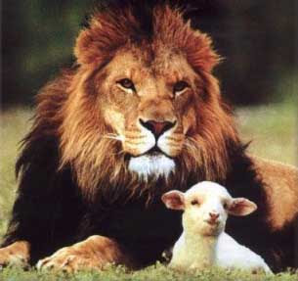
Worthy Is The
Lamb
"Do not weep. Behold, the Lion of the tribe of Judah, the Root of David, has prevailed to open the scroll and to loose its seven seals" (Rev. 5:5)

Slide 6
Worthy Is The
Lamb
"And I looked, and behold, in the midst of the throne and of the four living creatures, and in the midst of the elders, stood a Lamb as though it had been slain, having seven horns and seven eyes, which are the seven Spirits of God sent out into all the earth" (Rev. 5:6)

Slide 7
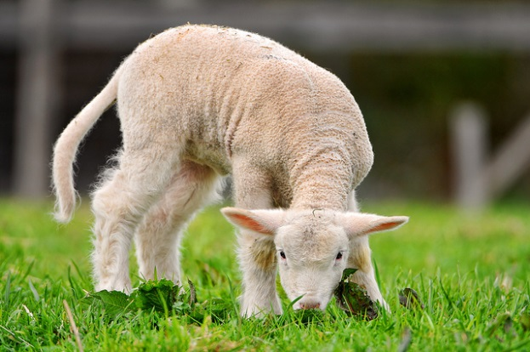
Worthy Is The
Lamb
"And I looked, and behold, in the midst of the throne and of the four living creatures, and in the midst of the elders, stood a Lamb as though it had been slain, having seven horns and seven eyes, which are the seven Spirits of God sent out into all the earth" (Rev. 5:6)

Slide 8
Worthy Is The
Lamb
" He was taken from prison and from judgment, And who will declare His generation? For He was cut off from the land of the living; For the transgressions of My people He was stricken" (Isaiah 53:8)

Slide 9
Will You COMMIT Your Life To The LAMB That Was Slain?
“For this is My blood of the new covenant, which is shed for many for the remission of sins” (Matt. 26:28)
“Repent, and let every one of you be baptized in the name of Jesus Christ for the remission of sins…” (Acts 2:38)

